Slide 1
7.4 NP完全性
金剑涵

Slide 2

可满足性问题
Defn: 布尔$公式 φ$ 是包含布尔变量(True/False values) 和布尔运算And ($∧$), Or ($∨$), and Not ($¬$)的表达式.
Defn: $φ$ is satisfiable if $φ$evaluates to True for some assignment to its variables.
Sometimes we use 1 for True and 0 for False.
Example: Let $φ= \left(x∨y\right)∧(\overline{x}∨\overline{y})$ (Notation: $\overline{x}$ means $¬x$)
Then $φ$ is satisfiable (x=1, y=0)
Defn: $SAT=\left\{〈φ〉\right| φ$ is a satisfiable Boolean formula}
Theorem (Cook, Levin 1971): $SAT∈$ P $→$ P = NP （LATER)
Proof method: polynomial time (mapping) reducibility

Slide 3











多项式时间可归约性
Defn: $A$ 多项式$时间可归约到 B$ ($A≤_{P}B$) 若 $A≤_{m}B$ 且规约函数多项式时间可计算
Theorem: If $A≤_{P}B$ and $B∈$P then $A∈$ P.
$$A$$
$$f$$
$$B$$
NP
$f$ is computable in polynomial time
$$SAT$$
T-recognizable
P
$$≤_{P}$$
$$A\text{TM}$$
decidable
$$≤_{m}$$
Idea to show $SAT∈$ P $→$ P = NP
Analogy with $A\text{TM}$

Slide 4



$≤_{P}$ 举例: $3SAT$ and $CLIQUE$
Defn: A Boolean formula $φ$ is in Conjunctive Normal Form (CNF) if it has the form $φ= \left(x∨\overline{y}∨z\right) ∧ \left(\overline{x}∨\overline{s}∨z∨u\right) ∧⋯∧ (\overline{z}∨\overline{u})$
clause
clause
literals
文字（Literal）: a variable or a negated variable
子句（Clause）: an OR ($∨$) of literals.
合取范式（CNF）: an AND ($∧$) of clauses.
3CNF: a CNF with exactly 3 literals in each clause.
$3SAT=\left\{〈φ〉\right| φ$is a satisfiable 3CNF formula}
Defn: A $k$-clique in a graph is a subset of k nodes all directly connected by edges.
$CLIQUE=\left\{〈G,k〉\right|$graph $G$ contains a $k$-clique}
Will show: $3SAT≤_{P}CLIQUE$
3-clique
4-clique
5-clique

Slide 5




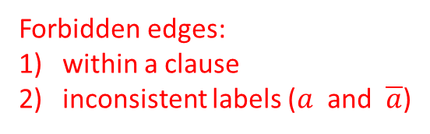














$$3SAT≤_{P}CLIQUE$$
Theorem: $3SAT≤_{P}CLIQUE$
Proof: Give polynomial-time reduction $f$ that maps $φ$ to $G,k$ where $φ$ is satisfiable iff $G$ has a $k$-clique.
一个 CNF 公式的满足赋值在每个子句中至少有一个文字为真.
$φ = \left(a∨b∨\overline{c}\right) ∧ \left(\overline{a}∨b∨d\right) ∧ \left(a∨c∨\overline{e}\right) ∧ ⋯ ∧ \left(\overline{x}∨y∨\overline{z}\right)$
$$f$$
$$a$$
$$\overline{c}$$
$$\overline{a}$$
$$d$$
$$a$$
$$\overline{e}$$
$$\overline{x}$$
$$\overline{z}$$
$$G$$
$$k$$
$$=$$
. . .
$$b$$
$$b$$
$$c$$
$$y$$
$=$ # clauses
Forbidden edges:
within a clause
inconsistent labels ($a$ and $\overline{a}$)
$G$ has all non-forbidden edges

Slide 6


NP完全性
Defn: $B$ 是NP完全的 若
$B∈$NP
For all $A∈$NP, $A≤_{P}B$
If $B$ is NP-complete and $B∈$P then P $=$ NP.
Importance of NP-completeness
1) Showing $B$ is NP-complete is evidence of computational intractability.
2) Gives a good candidate for proving P $≠$ NP.

Slide 7

库克-列文定理
Theorem: $SAT$ is NP-complete
Proof: 1) $SAT∈NP$ (done)
2) Show that for each $A∈NP$ we have $A≤_{P}SAT$:
假设 $A∈NP$ 由非确定性图灵机(NTM) $M$ 在 $n^{k}$ 时间内决定.
给出一个多项式时间归约 f 将 A 映射到 SAT.
$f: Σ^{∗}→ 布尔$公式
$f\left(w\right) = 〈φ_{M,w}〉$
$w∈A$ iff $φ_{M,w}$ is satisfiable
Idea: $φ_{M,w}$ simulates $M$ on $w$. 设计 $φ_{M,w}使其表示(\text{"}\text{say}\text{"})M$ 接受 $w$.
$φ_{M,w}$ 的满足赋值是 $M$ 在 $w$上的计算历史.

Slide 8









$M$ 在 $w$上的对应画面(Tableau)
Defn: An (accepting) tableau for NTM $M$ on $w$ is an $n^{k}×n^{k}$ table
表示的是 M 在接受分支上对于非确定性计算的计算历史
$$n^{k}$$
˽ … ˽
$$q_{0}$$ | $$w_{1}$$ | $$w_{2}$$ | $w_{3} ⋯ w_{n}$
a | $$q_{7}$$ | $$w_{2}$$ | $⋯$
 |  |  | $⋯ q\text{accept} ⋯$
$←$起始配置（初始状态和输入符号）
Construct $φ_{M,w}$ to “say” $M$ accepts $w$.
$φ_{M,w}$ “says” a tableau for $M$ on $w$ exists.
$φ_{M,w}=φ\text{cell} ∧ φ\text{start}$ $∧ φ\text{move}$ $∧ φ\text{accept}$
$$⋮$$
$$n^{k}$$
$← 接受$配置（接受状态）

Slide 9






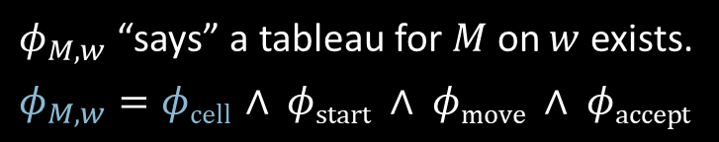








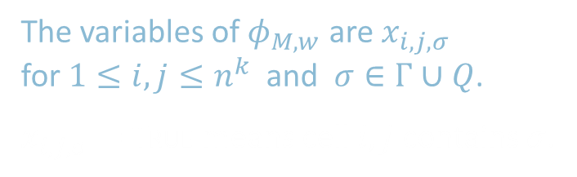







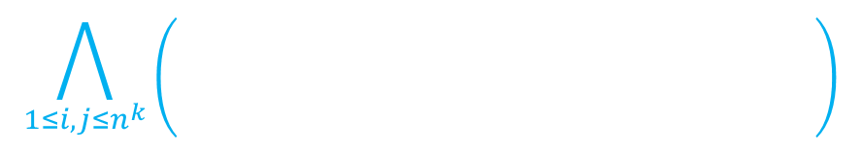
Constructing $φ_{M,w}$: $φ\text{cell}$（每个单元格）
$$j$$
˽ … ˽
$$q_{0}$$ | $$w_{1}$$ | $$w_{2}$$ | $w_{3} ⋯ w_{n}$
a | $$q_{7}$$ | $$w_{2}$$ | $⋯$
 |  |  | $⋯ q\text{accept} ⋯$
˽
˽
$$q_{7}$$
$$i,j$$
$$q_{7}$$
a
a
˽
˽
a
$$i$$
a
$$q_{7}$$
$$q_{7}$$
$φ_{M,w}$ “says” a tableau for $M$ on $w$ exists.
$φ_{M,w}=φ\text{cell} ∧ φ\text{start}$ $∧ φ\text{move}$ $∧ φ\text{accept}$
a
b
˽
$$q_{7}$$
$$⋯$$
$$⋯$$
$$⋯$$
Cell $i,j$ can contain any symbol in $Γ(字母表)∪Q$(状态集)
$φ\text{cell}$ “says” exactly one light is on per cell
i.e., exactly one $x_{i,j,σ}=$ True for each $i,j$ .
lights represent $x_{i,j,σ}$
$x_{i,j,q_{7}}$= True
$x_{i,j,\text{˽}}$ = True
$x_{i,j,\text{a} }$= True
In every cell at least one light and at most one light
The variables of $φ_{M,w}$ are $x_{i,j,σ}$ for $1≤i,j≤n^{k}$ and $σ∈Γ∪Q$.
$x_{i,j,σ}=$ True means cell $i,j$ contains $σ$.
$$x_{i,j,σ_{1}} ∨ x_{i,j,σ_{2}} ∨⋯∨ x_{i,j,σ_{t}}$$
1≤𝑖,𝑗≤𝑛𝑘𝜎∈Γ∪𝑄𝑥𝑖,𝑗,𝜎 ∧ 𝜎,𝜏∈Σ∪𝑄𝜎≠𝜏 𝑥𝑖,𝑗,𝜎∧𝑥𝑖,𝑗,𝜏
$$\bigvee_{σ∈Γ∪Q}{x_{i,j,σ}}$$
$$∧$$
$$\bigwedge_{{σ,τ ∈Γ∪Q \atop σ ≠ τ}}{\left( \overline{x_{i,j,σ}∧x_{i,j,τ}} \right) }$$
$$φ\text{cell} =$$

Slide 10





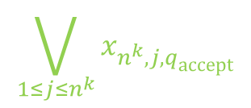



Constructing $φ_{M,w}$: $φ\text{start}$ and $φ\text{accept}$
1 $⋯ n^{k}$
1
2
3 $⋯ n^{k}$
1
˽ … ˽
$←$Start configuration
$$q_{0}$$ | $$w_{1}$$ | $$w_{2}$$ | $w_{3} ⋯ w_{n}$
a | $$q_{7}$$ | $$w_{2}$$ | $⋯$
 |  |  | $⋯ q\text{accept} ⋯$
$φ_{M,w}$ “says” a tableau for $M$ on $w$ exists.
$φ_{M,w}=φ\text{cell} ∧ φ\text{start}$ $∧ φ\text{move}$ $∧ φ\text{accept}$
$φ\text{cell}$ done ✓
$φ\text{start}$ $=x_{1,1,q_{0}} ∧ x_{1,2,w_{1}}∧ x_{1,3,w_{2}}∧ ⋯ ∧x_{1,n^{k},\text{˽}}$
$φ\text{accept}$ $=$
$$n^{k}$$
$←$Accepting configuration
$$\bigvee_{1≤j≤n^{k}}{x_{n^{k},j,q\text{accept}}}$$

Slide 11



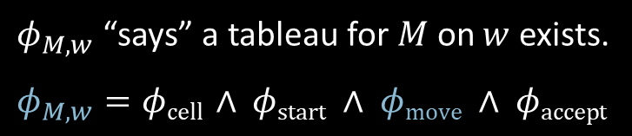










Constructing $φ_{M,w}$: $φ\text{move}$
$$j$$
˽ … ˽
$$q_{0}$$ | $$w_{1}$$ | $$w_{2}$$ | $w_{3} ⋯ w_{n}$
a | $$q_{7}$$ | $$w_{2}$$ | $⋯$
 |  |  | $⋯ q\text{accept} ⋯$
$2×3$ neighborhood
$$i$$
Legal neighborhoods: consistent with $M$’s transition function
potential examples:
a | $$q_{7}$$ | b
$$q_{3}$$ | a | c
a | b | c
a | b | c
a | b | c
a | b | $$q_{5}$$
a | b | c
d | b | c
Illegal neighborhoods: not consistent with $M$’s transition function
$φ_{M,w}$ “says” a tableau for $M$ on $w$ exists.
$φ_{M,w}=φ\text{cell} ∧ φ\text{start}$ $∧ φ\text{move}$ $∧ φ\text{accept}$
examples:
a | b | c
a | d | c
a | b | c
a | $$q_{2}$$ | c
a | $$q_{7}$$ | c
a | b | c
a | $$q_{7}$$ | c
$$q_{3}$$ | d | $$q_{4}$$
✓
✓
✓
Claim: 若每一个窗口都是合法的，则画面每一行都是上一行合法转移得到的格局.
1<𝑖,𝑗<𝑛𝑘𝜎∈Γ∪𝑄𝑥𝑖,𝑗,𝜎 ∧ 𝜎,𝜏∈Σ∪𝑄𝜎≠𝜏 𝑥𝑖,𝑗,𝜎∧𝑥𝑖,𝑗,𝜏
$$\bigvee{ \left( x_{i,j−1,\text{r} } ∧ x_{i,j,\text{s} } ∧ x_{i,j+1,\text{t} } ∧ x_{i+1,j−1,\text{v} } ∧ x_{i+1,j,\text{y} } ∧ x_{i+1,j+1,\text{z} } \right) }$$
$$φ\text{move} =$$
Legal
Says that the neighborhood at $i,j$ is legal
r | s | t
v | y | z

Slide 12





Conclusion: $SAT$ is NP-complete
$$n^{k}$$
˽ … ˽
$$q_{0}$$ | $$w_{1}$$ | $$w_{2}$$ | $w_{3} ⋯ w_{n}$
a | $$q_{7}$$ | $$w_{2}$$ | $⋯$
 |  |  | $⋯ q\text{accept} ⋯$
Summary:
For $A∈\text{NP}\text{,}$ decided by NTM $M$, we gave a reduction $f$ from $A$ to $SAT$:
$f: Σ^{∗} →$formulas
$f\left(w\right) = 〈φ_{M,w}〉$
$w∈A$ iff $φ_{M,w}$ is satisfiable.
$φ_{M,w}=φ\text{cell} ∧ φ\text{start}$ $∧ φ\text{move}$ $∧ φ\text{accept}$
The size of $φ_{M,w}$ is roughly the size of the tableau for $M$ on $w$, so size is $O\left(n^{k}×n^{k}\right)=O\left(n^{2k}\right)$.
Therefore $f$ is computable in polynomial time.
$$n^{k}$$

Slide 13













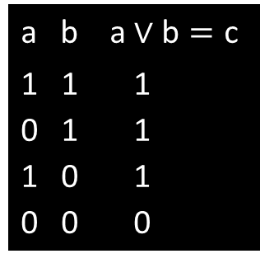



$3SAT$ is NP-complete
a b a $∨\text{b}=\text{c}$
1 1 1
0 1 1
1 0 1
0 0 0
a b a $∧\text{b}=\text{c}$
1 1 1
0 1 0
1 0 0
0 0 0
$$\left(\text{a}∧\text{b}\right)→\text{c}$$
$$\left(\overline{\text{a}}∧\text{b}\right)→\text{c}$$
$$\left(\text{a}∧\overline{\text{b}}\right)→\text{c}$$
$$\left(\overline{\text{a}}∧\overline{\text{b}}\right)→\overline{\text{c}}$$
$$\left(\text{a}∧\text{b}\right)→\text{c}$$
$$\left(\overline{\text{a}}∧\text{b}\right)→\overline{\text{c}}$$
$$\left(\text{a}∧\overline{\text{b}}\right)→\overline{\text{c}}$$
$$\left(\overline{\text{a}}∧\overline{\text{b}}\right)→\overline{\text{c}}$$
Theorem: $3SAT$ is NP-complete
Proof: Show $SAT≤_{P}3SAT$
Give reduction $f$ converting formula $φ$ to 3CNF formula $φ′$, preserving satisfiability.
(Note: $φ$ and $φ′$ are not logically equivalent)
Example: Say $φ=\left(\left(\text{a}∧\text{b}\right) ∨ \text{c}\right) ∧ \left(\overline{\text{a}}∨\text{b}\right)$
Tree structure for $φ$:
Logical equivalence: $\left(A→B\right)$ and $\left(\overline{A}∨B\right)$ $\overline{\left(A∧B\right)}$ and $\left(\overline{A}∨\overline{B}\right)$
$$φ^{′}= \left(\left(\text{a}∧\text{b}\right)→z_{1}\right) ∧ \left(\left(\overline{\text{a}}∧\text{b}\right)→\overline{{\text{z}}_{1}}\right) ∧ \left(\left(\text{a}∧\overline{\text{b}}\right)→\overline{{\text{z}}_{1}}\right) ∧ \left(\left(\overline{\text{a}}∧\overline{\text{b}}\right)→\overline{{\text{z}}_{1}}\right)$$
$$z_{4}$$
$$∧$$
$$∧ \left(\left(z_{1}∧\text{c}\right)→z_{2}\right)∧\left(\left(\overline{{\text{z}}_{1}}∧\text{c}\right)→z_{2}\right) ∧ \left(\left(z_{1}∧\overline{\text{c}}\right)→z_{2}\right) ∧ \left(\left(\overline{{\text{z}}_{1}}∧\overline{\text{c}}\right)→\overline{{\text{z}}_{2}}\right)$$
$$z_{2}$$
$$∨$$
$$∨$$
$$z_{3}$$
$⋮$ repeat for each $z_{i}$
$$∧ (z_{4})$$
$$z_{1}$$
$$∧$$
c
$$\overline{\text{a}}$$
b
Observe that $\left(\left(\text{a}∧\text{b}\right)→\text{c}\right)$ is logically equivalent to $\left(\overline{\text{a}}∨\overline{\text{b}}∨\text{c}\right)$
a
b
$$\left[ \left(\left(\text{a}∧\text{b}\right)→\text{c}\right) ↔ \left(\overline{\left(\text{a}∧\text{b}\right)} ∨\text{c}\right) ↔ \left(\left(\overline{\text{a}}∨\overline{\text{b}}\right)∨\text{c}\right) ↔ \left(\overline{\text{a}}∨\overline{\text{b}}∨\text{c}\right) \right]$$

Slide 14
7.5 NP完全问题举例

Slide 15








$HAMPATH$ is NP-complete
Theorem: $HAMPATH$ is NP-complete
Proof: Show $3SAT≤_{P}HAMPATH$ (assumes $3SAT$ is NP-complete)
Idea: “Simulate” variables and clauses with “gadgets”
$φ = \left(x_{1}∨{\overline{x}}_{2}∨x_{3}\right) ∧ \left({\overline{x}}_{1}∨x_{2}∨x_{4}\right) ∧ ⋯ ∧ \left( \right)$
$$f$$
$$s$$
$$〈G,s,t〉$$
$$x_{1}$$
. . .
clause gadget
variable gadget
Zig-zag
Corresponds to setting $x_{1}$ True
Zag-zig
Corresponds to setting $x_{1}$ False

Slide 16



















Construction of $G$
$φ = \left(x_{1}∨{\overline{x}}_{2}∨x_{3}\right) ∧ \left({\overline{x}}_{1}∨x_{2}∨x_{4}\right) ∧ ⋯ ∧ \left( x_{m} \right)$
$$c_{1}$$
$$c_{2}$$
$$c_{k}$$
$m$ variables
$k$ clauses
$$G$$
$$s$$
$$c_{1}$$
$x_{1}$ positive in $c_{1}$
$$x_{1}$$
. . .
. . .
$$c_{2}$$
$x_{2}$ negated in $c_{1}$
$x_{1}$ negated in $c_{2}$
$$x_{2}$$
. . .
The reduction $f$ is computable in polynomial time.
. . .
. . .
$$c_{k}$$
Claim: $φ$is satisfiable iff $G$ has a Hamiltonian path from $s$ to $t$.
($→$) Take any satisfying assignment to $φ$.
Make corresponding zig-zags and zag-zigs through variable gadgets from $s$ to $t$.
Make detours to visit the clause nodes $c_{i}$.
($←$) Take any Hamiltonian path from $s$ to $t$.
Show it must be zig-zags and zag-zigs with detours to visit all $c_{i}$.
Get corresponding truth asst. It must satisfy $φ$because path visits all $c_{i}$.
. . .
$$x_{m}$$
. . .
$$t$$

